Slide 1
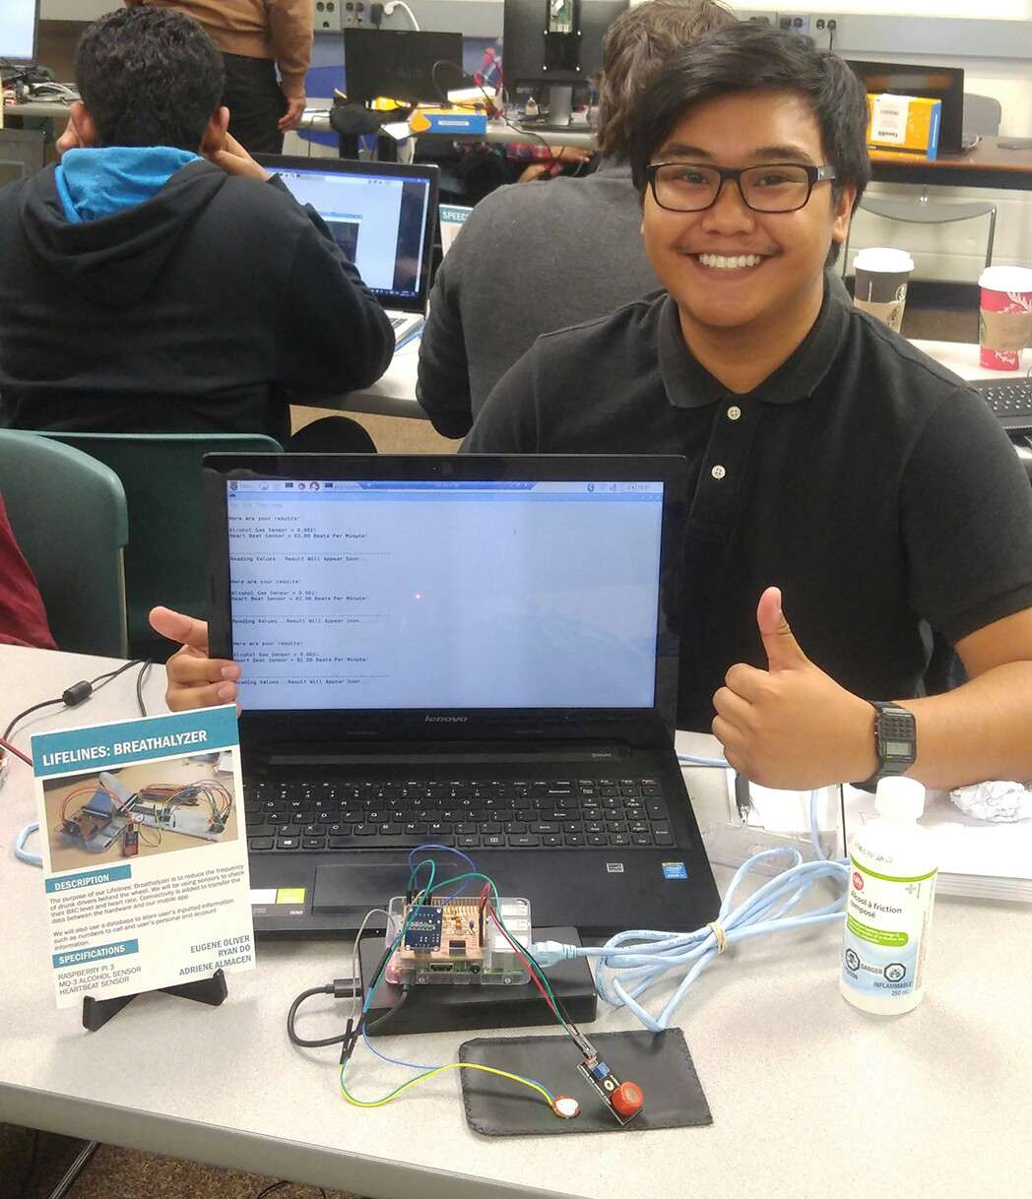

Lifelines: Breathalyzer By: Eugene Oliver

Slide 2

Introduction: (Proposal)
Why did I want to do this project? To help fix the problem of drinking and driving. The amount of drunk drivers need to be reduced around the world.
What will/does it do? Detects if there is alcohol in the system, and also checks the heart beat reading of the user.
Who will I be working with? Ryan Do and Adriene Almacen.

Slide 3
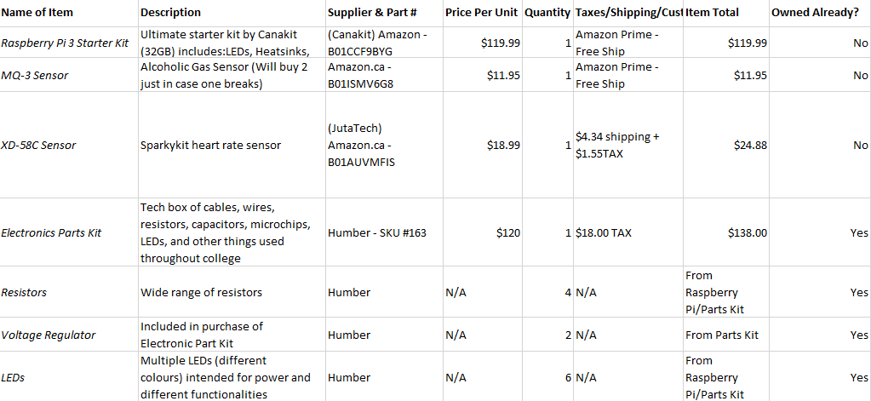
Budget:

Slide 4
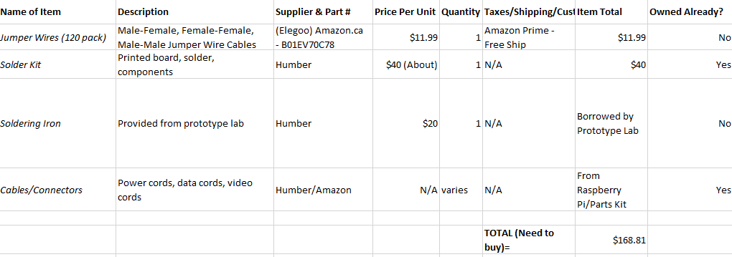
Budget:

Slide 5
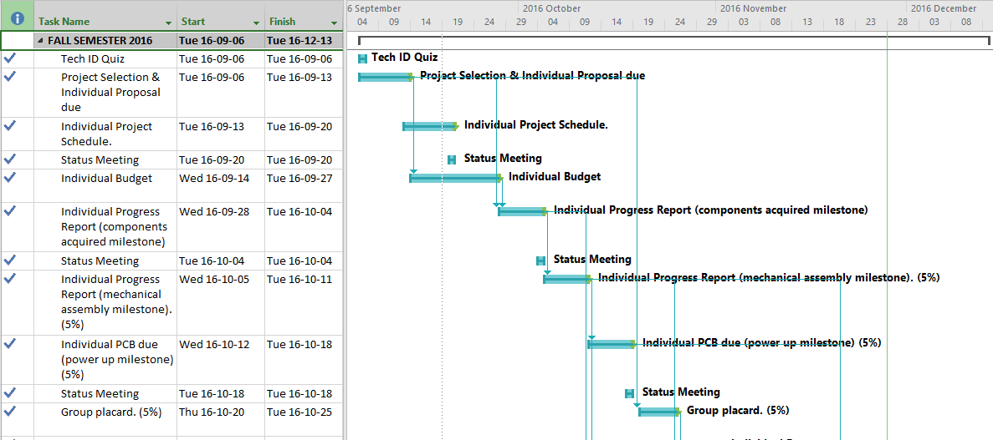
Schedule:

Slide 6
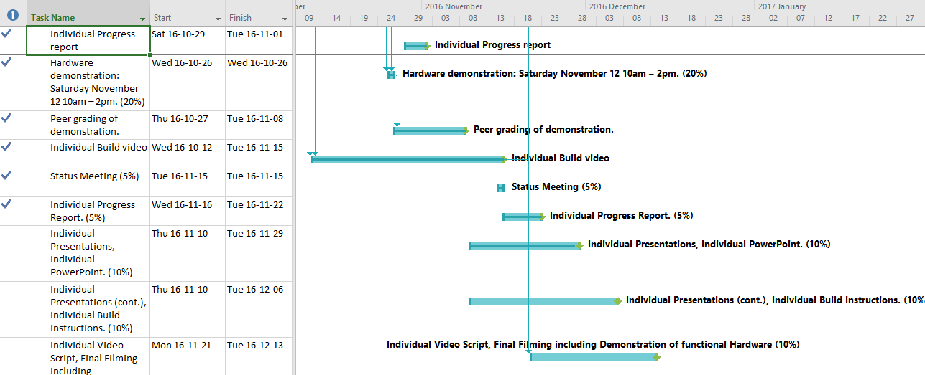
Schedule:

Slide 7
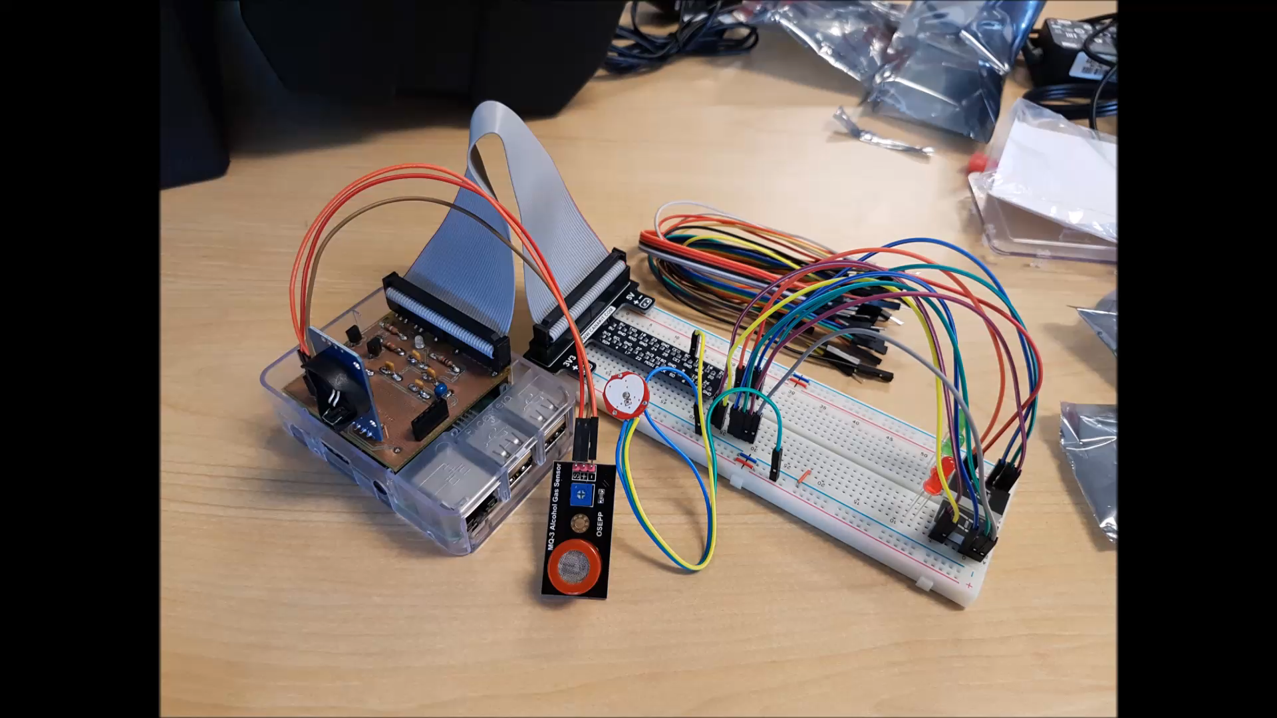
Build Video:

Slide 8
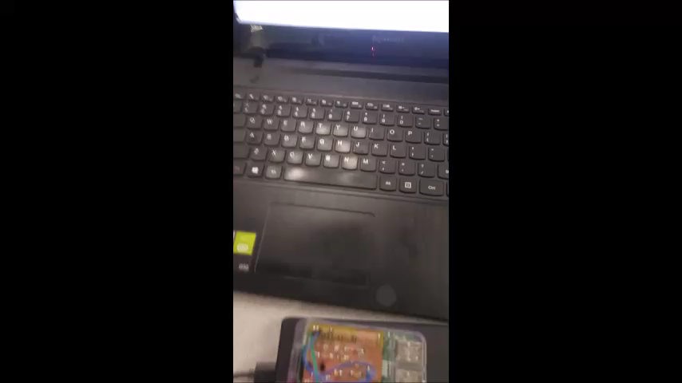
Open House: Proof it Works

Slide 9
Knowledge from previous courses
TECH 101 – Electric Circuits & TECH 150 – Electronic Devices and Circuits In these classes we learned how to properly test circuits and see how to get readings and make sure we’re getting proper readings. We also were introduced with ADCs.
CENG 215 – Digital and Interfacing Systems In this class we were further advanced in the construction of circuits, so we understood how things work in the circuit.
CENG 216 – Intro to Software Engineering In this class we got familiar with making budgets and were introduced to the use of GANTT charts.
**In the future, specifically next semester, courses such as CENG256, 252 & 254 will be a big help.

